Slide 1

TOTAL DEFENCE STRATEGY CARD GAME

Slide 2

Appreciate the complexity of the threats facing Singapore and the impact of everyday decisions.
Recognise that simple yet concrete actions can help our family and friends be more prepared for crises.

Slide 3


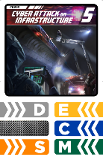

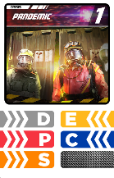


The need to strengthen all pillars of Total Defence to overcome national crises

Slide 4
The need to strengthen all pillars of Total Defence to overcome national crises
Why multiple pillars of Defence are required to overcome any one Crisis?

Slide 5

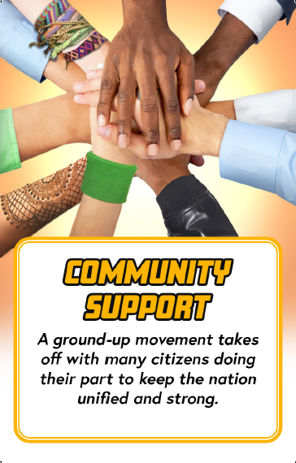
Playing of Community Support cards to strengthen the pillars of Total Defence
How vital was it to play the Community Support cards?

Slide 6
Playing of Community Support cards to strengthen the pillars of Total Defence
Community Support allows us to remain united and keep Singapore strong.

Slide 7
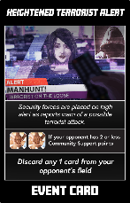
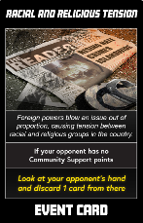
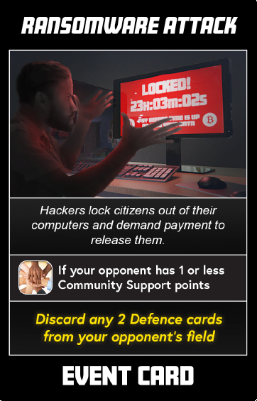
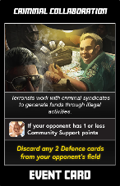
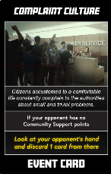
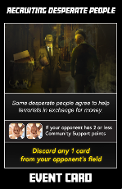
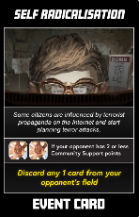
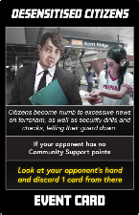
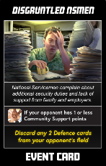
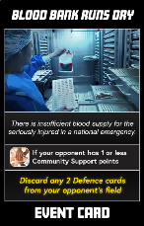
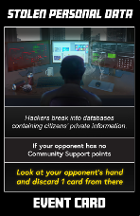
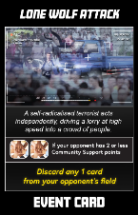
Reacting to effects of
Event cards
How prepared were you for events that occur?

Slide 8
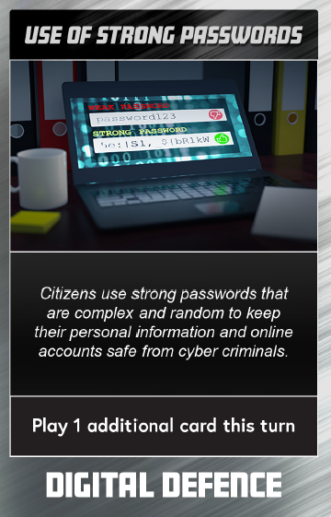
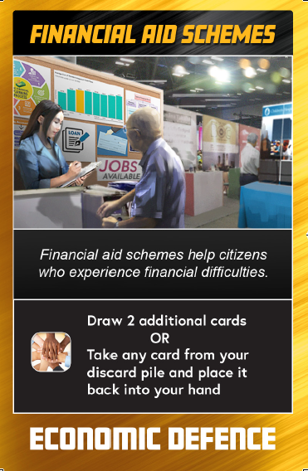
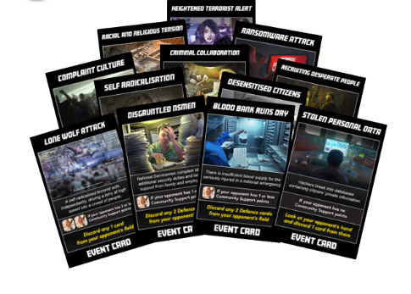
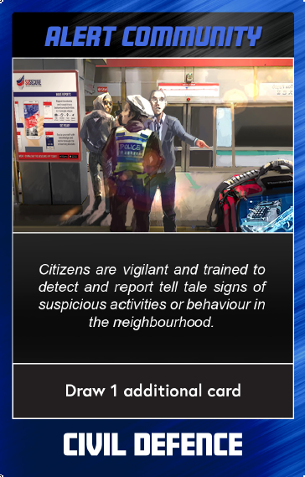
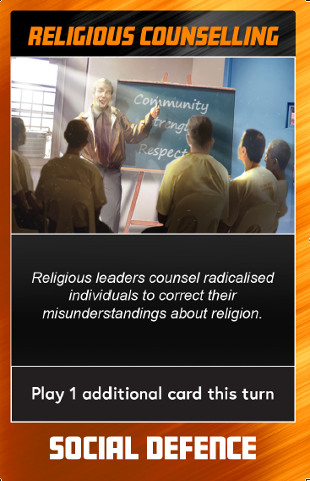
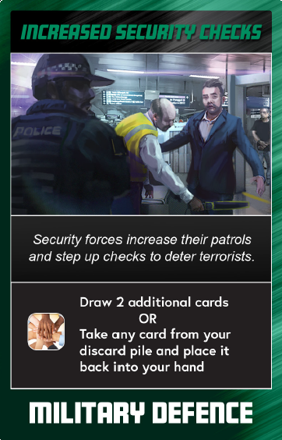
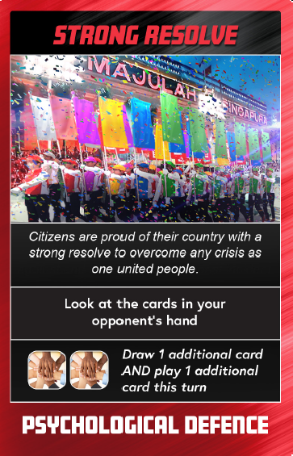
Reacting to effects of
Event cards
Did your strategies change because of an Event card?

Slide 9
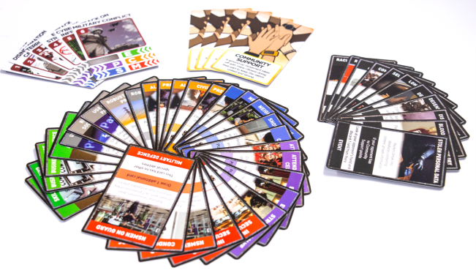
Gameplay and strategy
If you were to play the game again, what are some things you would do differently?

Slide 10



In May 2018, a series of bombings targeting religious institutions and the police were carried out by three families in Surabaya, Indonesia.

Slide 11

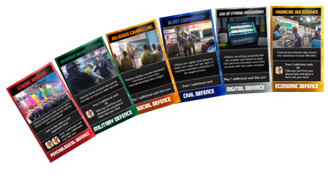
Look at the Defence cards
What can we do to prepare ourselves for an incident like this?
What are some ways in which we can respond when an incident like this happens?
How can we help our society recover from such an incident quickly?

Slide 12
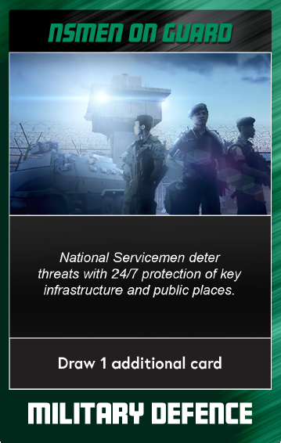
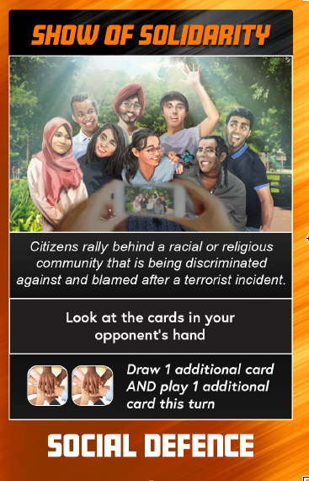
Terrorism is a real and present danger. It is not a matter of “if” but “when” an attack will happen.
We need to support our National Servicemen when they are called up for training or operations to keep us safe and secure.
Each of us has a part to play in safeguarding our harmony and way of life.

Slide 13


In June 2017, 12 countries closed off Qatar’s aviation routes and sea lanes.
Qatari airplanes and ships were banned from entering her neigbouring countries, affecting Qatar’s food supplies and economic trade.

Slide 14

What can we do
to prepare ourselves
for an incident like this?
Look at the Defence cards

Slide 15

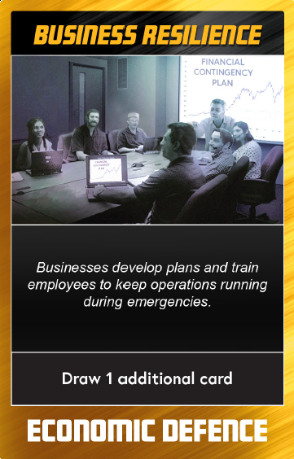
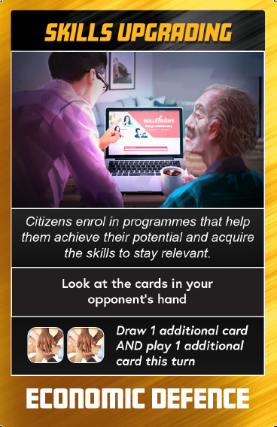
Businesses can develop contingency plans to ensure that we have good infrastructure, strong reserves and that our economy remains competitive.
We can play our part by retraining, upgrading, keep up with new technologies and new ways of doing things.
We cannot be complacent as situations like these can develop quickly and unexpectedly.

Slide 16


In July 2018, hackers stole information from 1.5 million patients from the SingHealth database.

Slide 17

Look at the Defence cards
What can we do to prepare ourselves for an incident like this?

Slide 18
Cyber attacks (either state-sponsored or by individuals) on infrastructure can cause significant damage to our economy and daily lives.
We can play our part by adopting good personal data protection and cyber security practices.

Slide 19



In 2017, documents were leaked from the French presidential candidate. Among documents that were leaked were fake emails. It was later discovered that the source of the leak was by a foreign power trying to affect the democratic process.

Slide 20
Look at the Defence cards
What can we do to prepare ourselves for an incident like this?
What are some ways in which we can respond when an incident like this happens?
How can we help our society recover from such an incident quickly?

Slide 21


Do not believe everything you read online. Check your facts and think about the implications of your actions before sharing.
We can play our part by not sharing messages that seek to incite hatred or discrimination against our fellow Singaporeans.

Slide 22

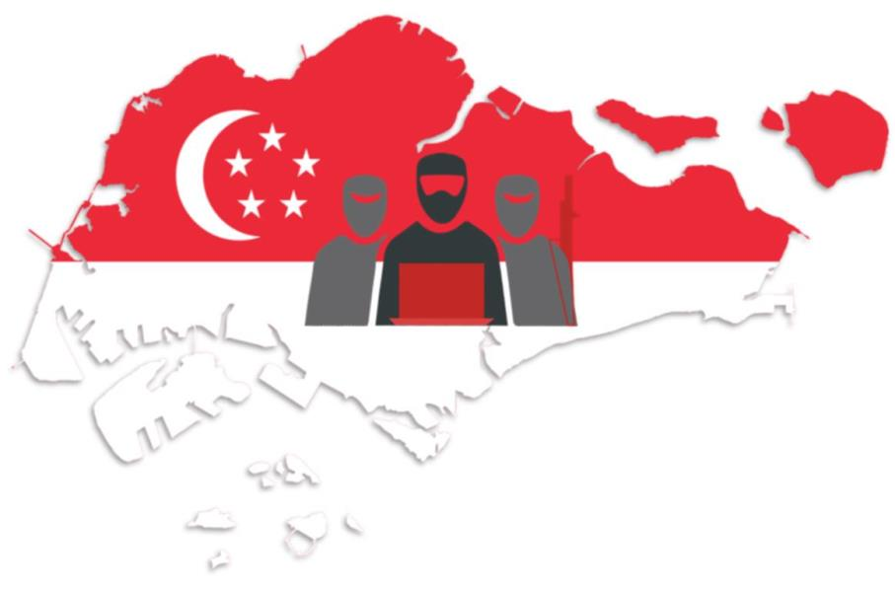
We’re facing
increasingly
complex threats.

Slide 23


Everyone needs to play a part, not just our security forces.

Slide 24

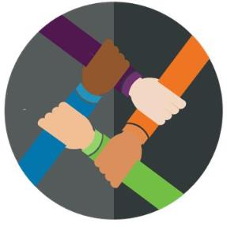


There are many things we can do to put Total Defence into action.

